Slide 1
Optimize OQC management process by software & Standardize electronic stamps
MAIN CONTENTS
1
Job History & Achievement
Page 1
2
Background Of Activities
Page 2~3
3
Total Improvement Schedule
Page 4
4
Detail Improvement Activity
Page 5~8
5
Confirm result & Next activities
Page 9~10
Presented by : Nguyen Nhu Minh
Join Date : 12-Feb-2019
Current Position : Officer
New Position : Supervisor
Department : ISD
Notes:
0.5m
Good morning/afternoon/evening everyone,
My name is Minh ,member of IT section. Today, I am very happy to be here to present my promotion report.
My topic is : “Optimize OQC management process by software & standardize electronic stamps”
Let’s begin: I talk about my self.

Slide 2
Job History & Achievement (2019 - 2024)
2/10
1/10
1.New Organization Chart
3. Job History & Achievements
ISD
GM Matsushita
Time | Projects Achievement
02/2019 | Start working in PSNV Officer of develop team
08/2019 | Auto print Stock card by Mobile printer for MCS Δ 2pax
11/2020 | Auto transfer kitting to SAP Δ 2pax
03/2021 | QC & MCS Free Location Δ 2pax
02/2022 | Sound Business Adding Serial Outer Weight Check Δ 3.9K$
03/2023 | Auto transfer to SAP for outside plan Δ 1pax
08/2024 | E-chop for IQC Δ 1pax
SCM Solution section
IT Planning section
M Chung
SAP team(3)
VBA team (2)
Infra team(3)
ISM team(2)
Development team
4
⬧ Specialist: Hien
⬧ Sup: Minh
⬧ 02 Officers
Analysis
2.My Assignment:
Current Job:
Develop new software
Maintain developed systems
Support users and all systems of IT
New Tasks:
Continue standardize & optimize procedures to reduce manual jobs
Support training & planning for manager to achieve KPI policy
Notes:
0.5m
Now, I introduce about my self.
We see in new Organization of ISD, I’m working in Develop team. my team have 4 people. I’m a in charge of Software development.
New assignment after promotion: …
There are some projects achievement 2019 - 2024.
the main of project achieve reduce HC ->Auto print Stock card by Mobile, auto transfer kitting to SAP, e chop for IQC..
…save time, ensure quantity for production.

Slide 3
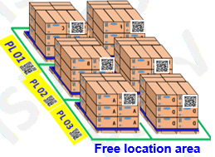
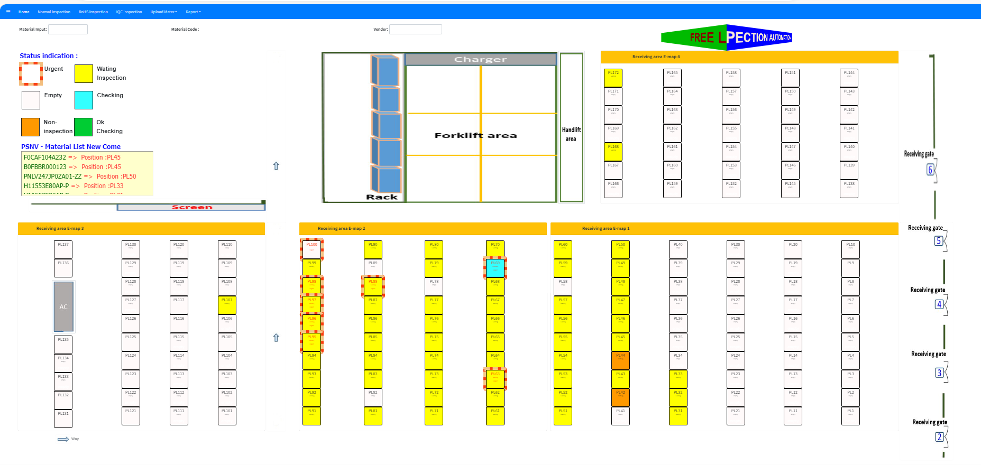

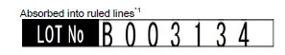
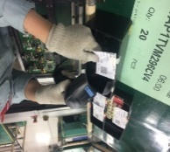
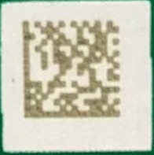
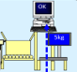

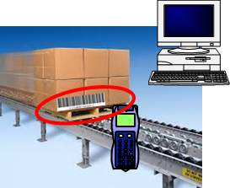

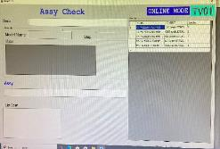
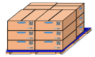
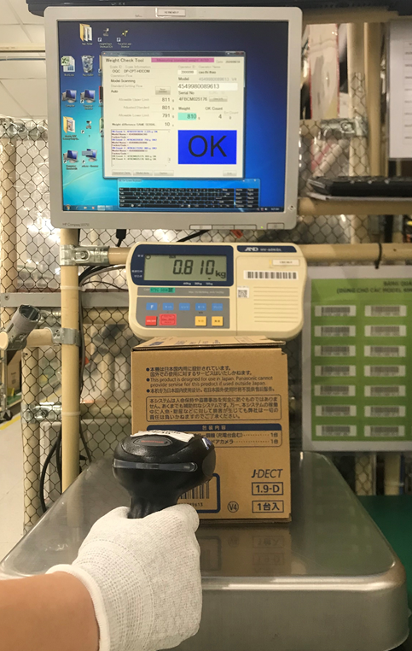
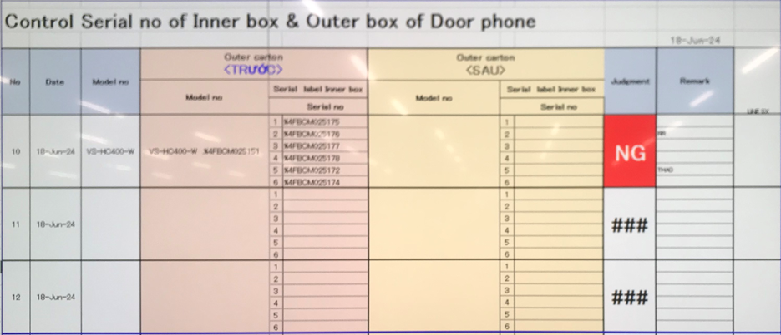

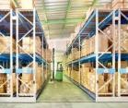

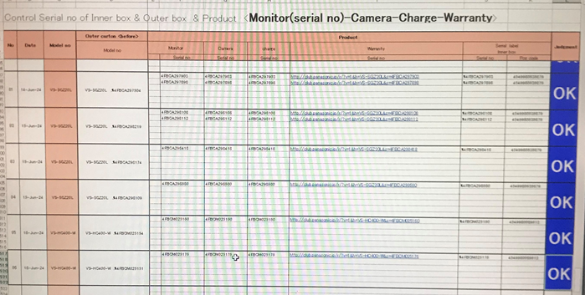
Background of Activities
2/10
2/10
PSNV business situation and IT mission
Sales Amount
Yearly Salary up
Fixed cost increase
197
208
245
220
216
Unit: $
IT missions
Sales not increase
5~7%
Reduce labor costs by IT automation
Strengthen factory streamline by IT automation for all Departments
MCS
IQC
SMT
DIP
FA
OQC
SCM
DB
DB
Sys
DB
DB
SAP
SAP
Scan Reel & check part
Verify part card
Weight & Traceability
100% Manual control
WMS & Tally Sheet
Smart W/H
E-Chop
Current process inspection sample of OQC
Off line
Off line
OK
DD-MM-YY
FA Line
❾
OQC
❶
Weight check 1st
❹
❺
❻
❼
❽
OQC chop stamp
❷
❸
Check outer 2nd
Step
Pick up sample
Check outer 1st
OQC inspection
Check Inner
Weight check 2nd
Return sample
SCM stock
❶,❽ Manual control pick up & return sample
❷,❼&❸,❻ Double job control offline
❹&❾Lost time to input Excel files & manual chop
❺ Easy to loss of data, take time to copy & paste
OQC has no system
Jobs still manual & lost time
Notes:
(1m)
The first, I’d like to explain background
For PSNV sale amount : the sale is not increase and rate yearly salary up 5-7%. So IT mission -> reduce labor cost by automation for all department
+We know all departments have management software and auto link other,
but OQC 100% still manually controls all steps by excel file an no link other system
+ let's look at the current process inspection at the OQC area
+ Each step is independent and not link other system => there are some problem: ……
this is reason I select OQC department to develop software because OQC no system and All step control manual by excel

Slide 4
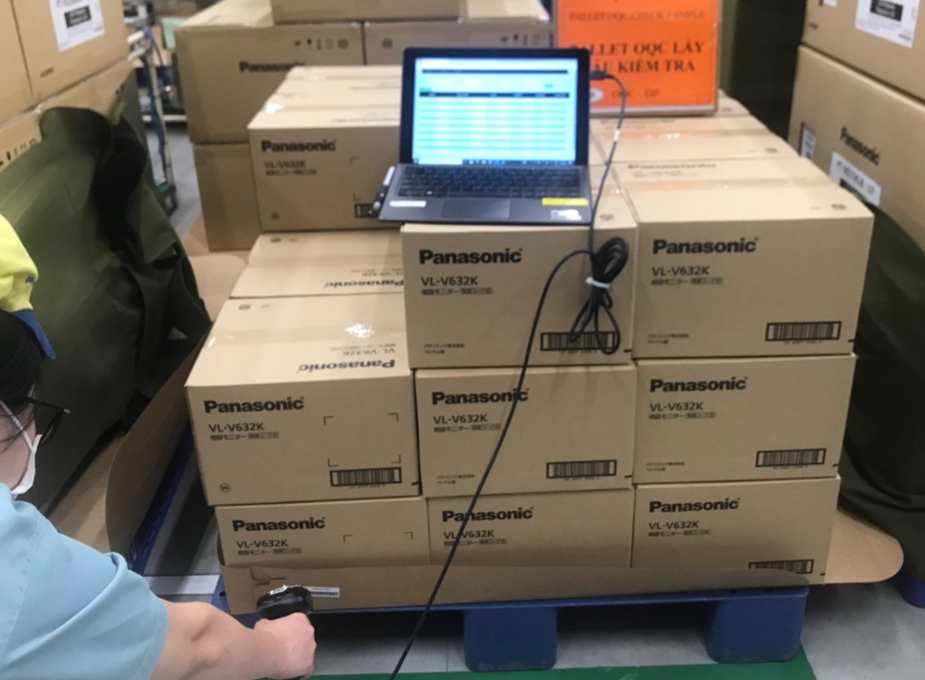
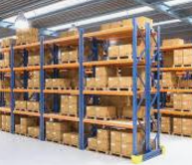
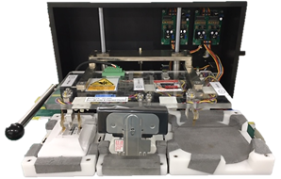


Background of Activities
2/10
3/10
My mission
Develop software to reduce manual jobs & ensure quality
Current Process Analysis
OK
Shrink machine
DD-MM-YY
5KG
OQC
FA production line
OQC inspection
FA stock
OQC chop physical stamp
SCM stock
Shipment
Theme 1: Optimize OQC management process by software
Theme 2: Standardize electronic stamps
Problem ①
Problem ②
Loss time to control by excel files
No link to other systems
Each step independent
➢ Skip process & easy mistakes
No system for management
Loss time to chop stamp manually.
Not enough space for keeping F/G at FA warehouse
Issue 1
Issue 2
OQC procedure with 100% manual control & not link other systems
OQC loss time to find Finished Goods (FG) & Chop stamps manually
Activity 1
Activity 2
1.1 Make software for all steps to reduce
manual jobs & Excel files
1.2 Make an auto-link function to visualize
SCM shipment shortage data
2.1 Make judgment function to evaluate
& visualize inspection result (OQC – FA)
2.2 Verify OQC judgment result to transfer
F/G to SCM for clearance FA W/H
Notes:
(1,5m)
The next slide, I talk about the issues of OQC department
Let's look at the detail current process OQC.
After pick up sample at production line, OQC inspection process include 8 step. All step manual job by excel file
The problem here : No link and skip process…..
This is issue 1 : OQC ..
I have activities 1 … 2… -> target: …
Let look at the next process: OQC chop stamps physical at the FA warehouse
The problem here :
No system for management chop stamp => Loss time to chop stamp manually
Not enough space for keeping F/G at FA warehouse
This is issue 2 : …
I have activities 3 … 4… -> target: …

Slide 5
Total Improvement Schedule
1/10
4/10
# | Theme | Activity | In charge (Main) | FY2024 Schedule |  |  |  |  |  |  |  | TARGET
 |  |  |  | Aug 24 | Sep 24 | Oct 24 | Nov 24 | Dec 24 | Jan 25 | Feb 25 | Mar 25
1 | Optimize OQC management process by software | Make software for all steps to reduce manual jobs & Excel files | ★ IT Minh OQC Tu FA Huong SCM Cuong |  |  |  |  |  |  |  |  | Reduce Manual job, Save time Δ1,000 (H/Year)
 |  | Make an auto-link function to visualize SCM shipment shortage data
2 | Standardize electronic stamps | Make judgment function to evaluate & visualize inspection result (OQC – FA) | ★ IT Minh OQC Tu FA Viet SCM Cuong |  |  |  |  |  |  |  |  | Reduce Δ2Pax Ensure Quality
 |  | Verify OQC judgment result to transfer F/G to SCM for clearance FA W/H
Analysis Discus
Standardize Develop
Discuss Develop
Testing Training
Analysis Discus
Standardize Develop
Discuss Develop
Testing Training
Analysis Discus
Develop Discuss
Testing Training
Analysis Discus
Develop Discuss
Testing Training
Analysis Discus
Standardize Develop
Testing Training
Analysis Discus
Develop
Testing
Analysis Discus
Develop Discuss
Testing Training
Analysis Discus
Develop Discus
Testing
Plan:
Actual:
Go-live:
Notes:
0.5m
Next slide, I talk about the total improvement schedule
With the 2 theme & 4 activities
The Schedule of project from Aug to Mar
Next slide, I will explain more detail for activity 1.

Slide 6
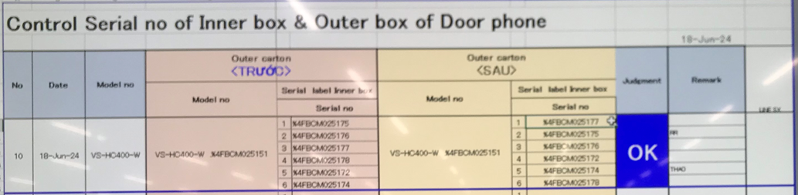
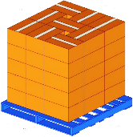
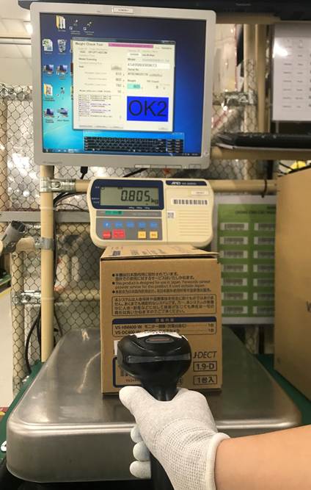
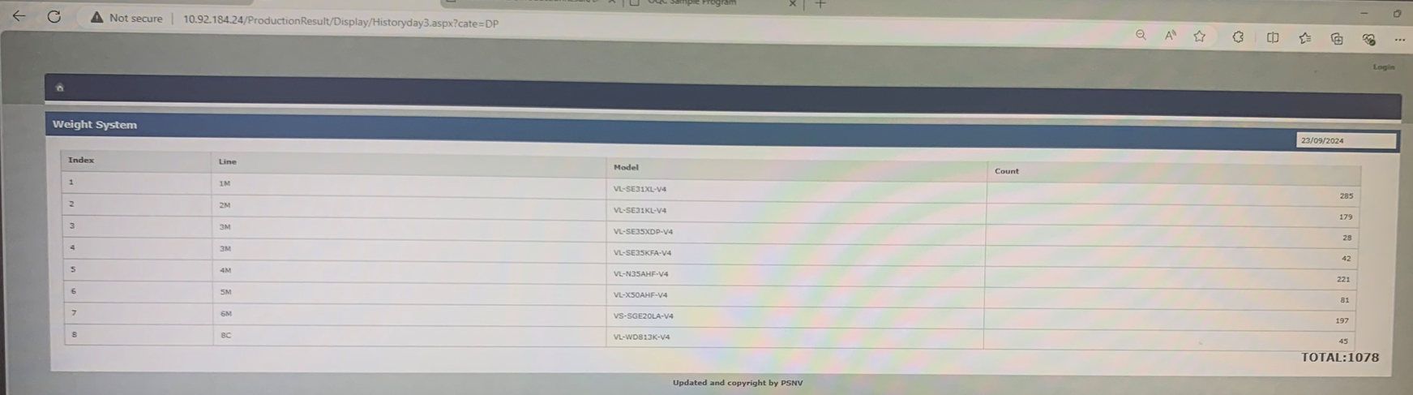
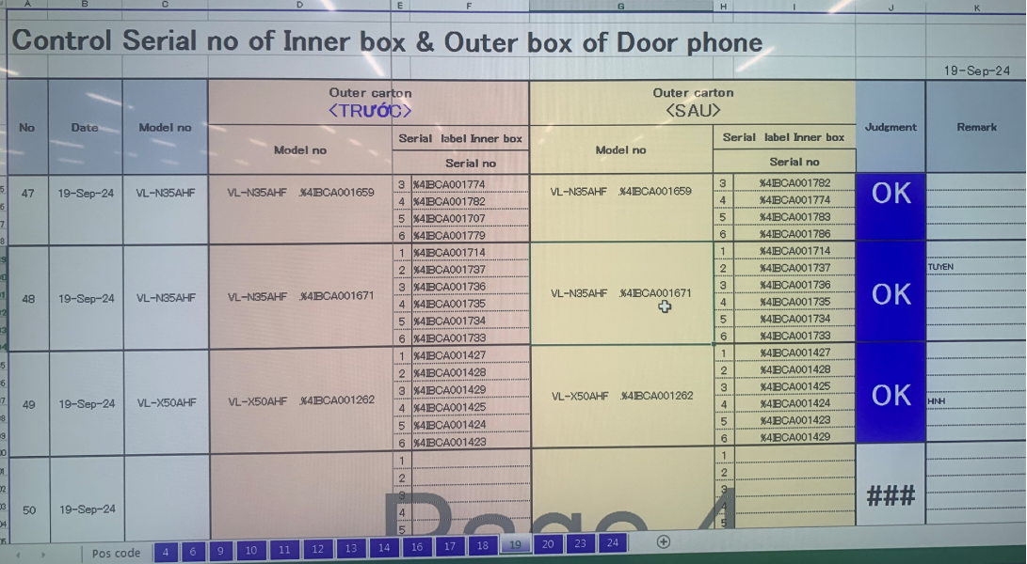
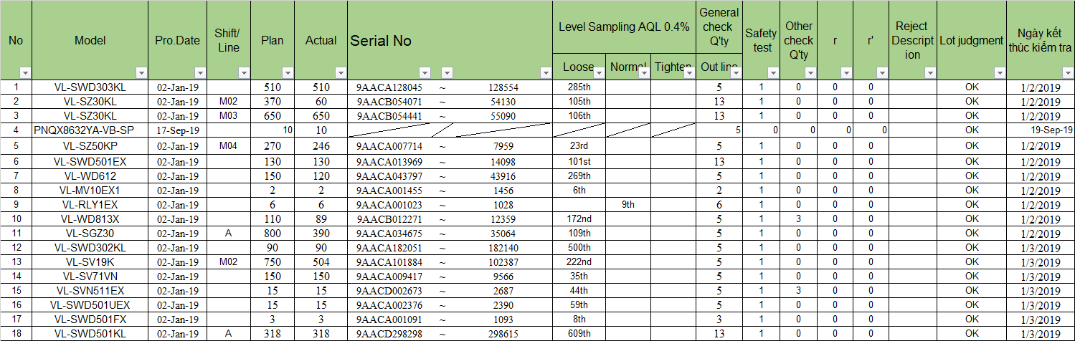









Detail Improvement Activity
5/10
Theme 1
Optimize OQC management process by software
Activity 1.1: Make software for all steps to reduce manual jobs & Excel files
Improvement actions
1. Analysis current OQC inspection process
Total using time: 1,248 H/Year
Weight check FA
Pick up sample
Scan serial outer box 1st
Weight check 1st
OQC
inspection
Scan serial inner box
Weight check 2nd
Scan serial outer box 2nd
Return sample
❶
(20min/day)
❷
(25min/day)
❸
(30min/day)
Reliability
❹
(20min/day)
❺ (40min/day)
❻ (50min/day)
❼
(25min/day)
❽
(20min/day)
2. Meeting & discuss: IT & OQC
⬥ Manual control all steps
⬥ Manual update OQC results
⬥ Wrong packing to market
Weight FA data
Off line
Loss time
to search
Double job
Copy & paste
inspection result
Manual input report daily
Take time to traceability
3. Optimize all step by software
❶
Develop App on tablet by barcode
❒ (30min/day)
❷
Develop software trace weight data FA
❒ (40min/day)
❸
Make Weight OQC online
❒ (50min/day)
❹
❽
Develop function check master data
❒ (80 min/day)
❼
❻
❺
FA line
1
2
3
4
5
6
7
8
Auto link
Weight check FA Data
Centralization OQC data
Efficiency
✓ Auto trace weight check data
✓ Pick up & return sample by barcode
✓ Auto make report daily
✓ Easy traceability
Time remain
288 H/Year
✓ Prevent skip process
✓ Reduce process ❷&❸
✵ Standardize OQC inspection process by software (Save time: 960 H/Year)
Notes:
1,5m
activities 1.1: …..
We are look at the OQC inspection process.
All step manual job control by excel.
Each step is independent no link other system.
After the meeting discuss IT & OQC I found that:
+loss time to search the serial range to pick up sample
+ double job to control offline
+ loss time to copy & page result, manual input daily, take time to traceability
To solve problem My solution: optimize all step inspection OQC by software
1. Step 1,8
2. Step 2,7=>=> reduce double job
3. Step 3,6 make weight check online => reduce double job
4. Step 4,5 Develop soft to check mater data reduce excel file.
+Make function auto link all step not skip process => ensure quality
Target this action : save time 960h/year

Slide 7
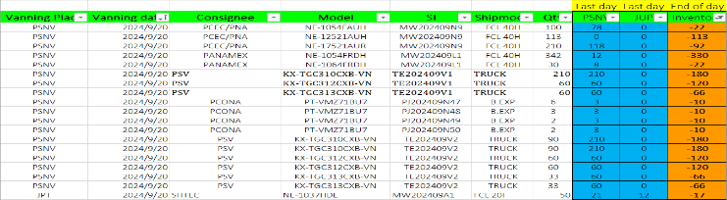
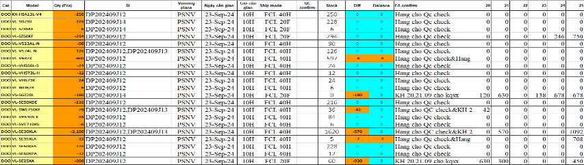
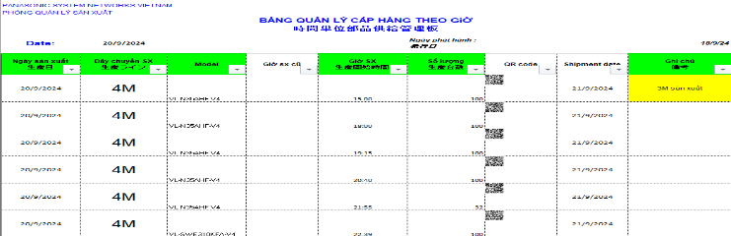

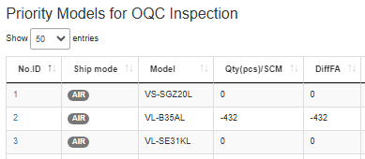
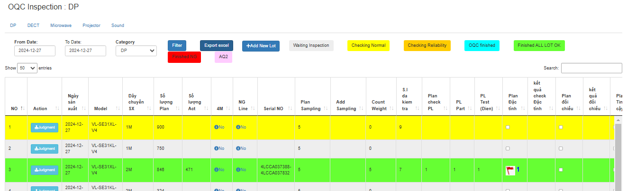

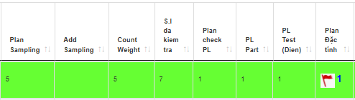
Detail Improvement Activity
6/10
Theme 1
Optimize OQC management process by software
Activity 1.2: Make an auto-link function to visualize SCM shipment shortage data
Improvement actions
1. Analysis current Situation
Send mail
Send mail
Send mail
SCM
FA
OQC
PCS
① Send inventory
& shipment plan
② Update inventory
& shipment plan
③ Process Excel files manually
④ Send daily
production plan
2. Meeting & discuss: IT - OQC - SCM
Total using time: 144 H/Year
①②③ OQC system no link shortage shipment of SCM, loss time to control job by Excel file
③ OQC loss of time to add more information related to the inspection lot
⬥ No indicated shipment priority, stock quantity, shipment quantity (take 20 min/day)
⬥ Manual input sample quantity, PL, Characteristic, Reliability… (take 10 min/day)
3. Develop functions auto link OQC system & shortage shipment SCM
Time remain
24 H/Year
SCM
③
Create auto-link
SCM data
①
OQC system
Shipment Quantity
Ship by air
Not manual input
Make function
update inventory
FA
Make function auto link master data
②
Visualize shipment priority
Auto update data
✵ IT automation for OQC to reduce manual job (Save time: 120H/Year)
Notes:
1,5m
This slide I explain the detail activities 1.2:
Current situation: Daily SCM department send shortage shipment plan via email for FA. FA compare stock an update file and send mail again OQC so all department loss time to manual control shortage shipment.
After that: OQC take time to add more information of production plan to inspection
My solution: I hold meeting and discus OQC,FA,SCM,
I connect create auto link OQC system with SCM data & FA data to visualize shipment priority &
make function upload production plan for OQC auto link mater data
Purpose :
+OQC Focus priority lot inspection for shipment.
+ auto update data when OQC inspection
Merit: save time more 100h/year & ensure quality

Slide 8


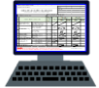
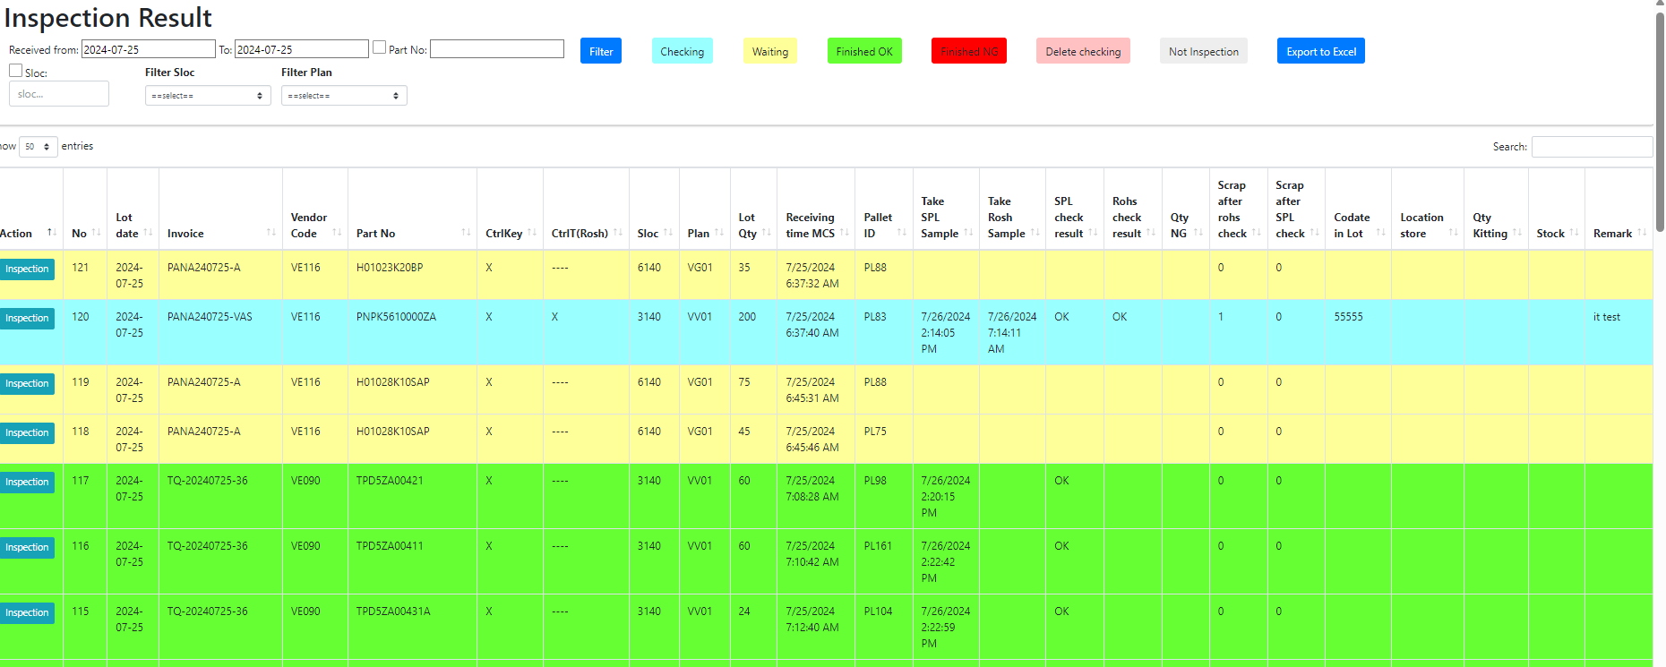

Detail Improvement Activity
1/10
7/10
Theme 2
Standardize electronic stamps
Activity 2.1: Make judgment function to evaluate & visualize inspection result (OQC – FA)
Improvement actions
1. Analysis current OQC process chop stamp
① Find Pallet ID & F/G
② Matching Pallet ID & S/N Outer
③ Read ID Pallet & S/N carton box
④ Find all production lots
⑤ Manual chop stamp all lots
⑥ Make Report daily
Weight check FA
OQC inspection
2. Meeting & discuss: IT-OQC-FA
Total time chop: 960mins/day ~ 2pax
OQC take time define lot production FA
OQC manual control to judgment all lots
⧫ Loss time to find, summarize and control lot
⧫ FA,SCM manual to confirm stamp by eyes
3. Create electronic stamps for OQC
E–chop replace physical stamp
Software
①
②
③
④
⑤
⑥
Modify weight FA
OK
OQC Inspection
DD-MM-YY
NG
FA warehouse
OQC
OQC System
OK
OK
Visualize OQC inspection
Auto define finish lot & judgment all lot
Check e–chop
FA Out location
SCM
✵ Replace physical stamps with electronic stamps system (Reduce 2pax)
Notes:
1m
The next slide I talk about the detail activity 2.1.
We see the OQC process chop stamp.
All process are manual job -> Take time the define Lot
Take time to judgment all lot the same model, line, production date. Loss time to define production lot of FA.
Actually OQC need 2pax/day to chop physical stamp
My improvement:
The first: I modify weight check FA auto to define production LOT after end shift or change model
The second: I make software inspection 8 step of OQC.
so finish all 2 condition: new system auto define finish lot, after that I make function auto Judgment all lot and visualize for FA
I make function check E-chop for FA & SCM replace visual check by eyes.
Result : we replace the physical temp by electronic temp & Reduce 2Pax

Slide 9





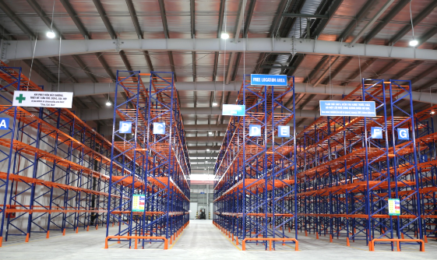
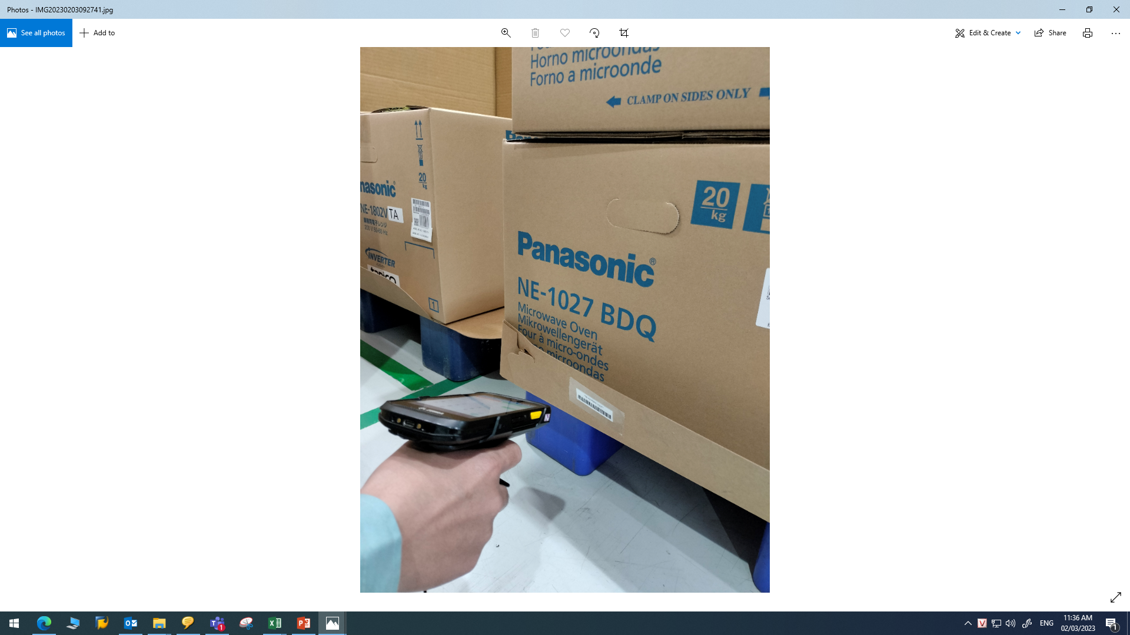
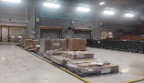
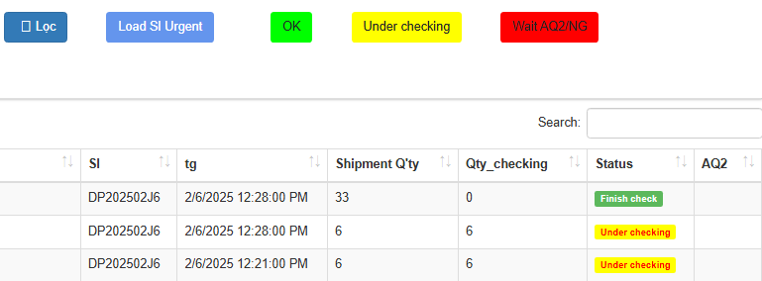
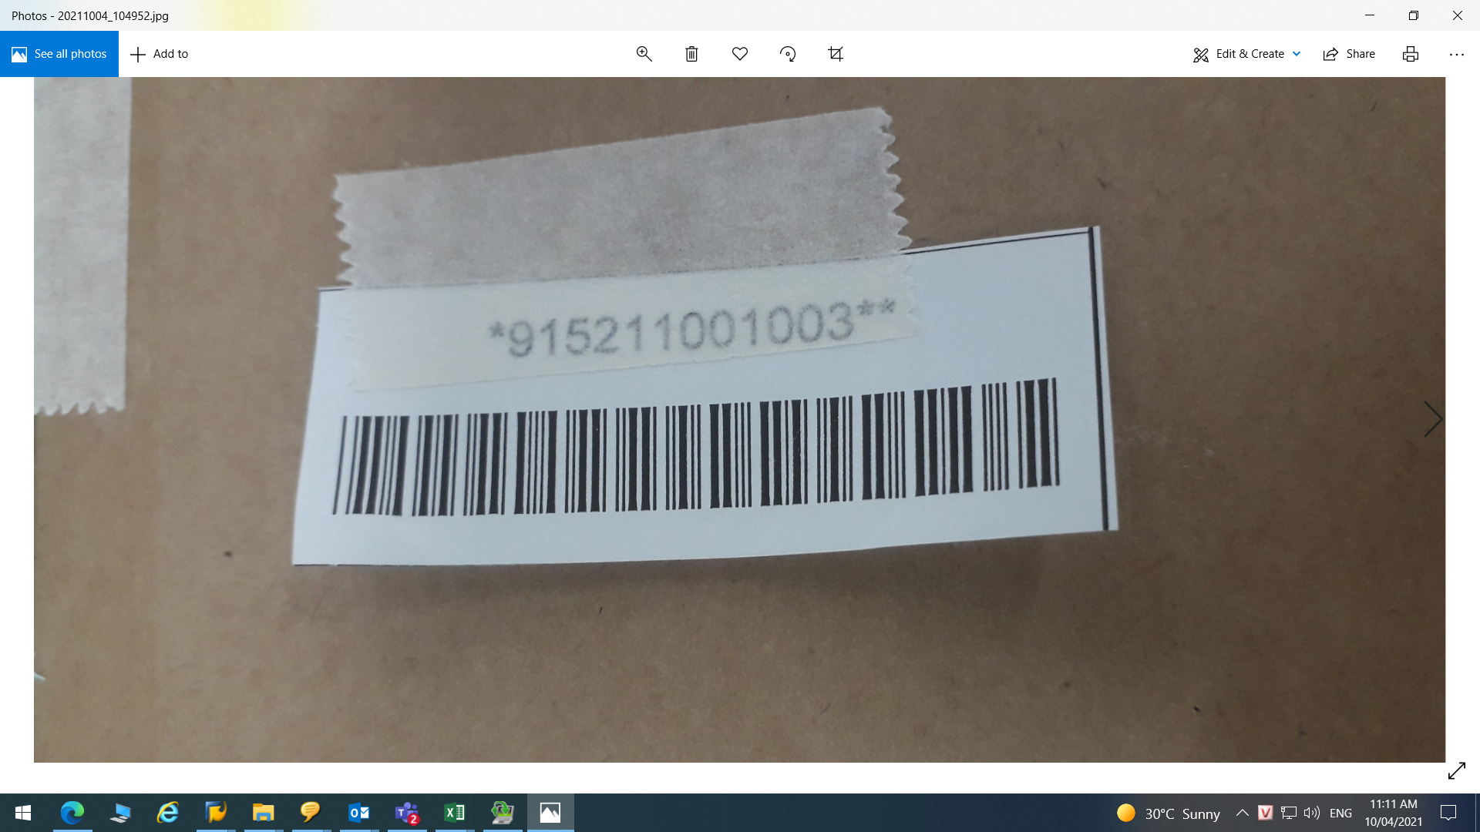
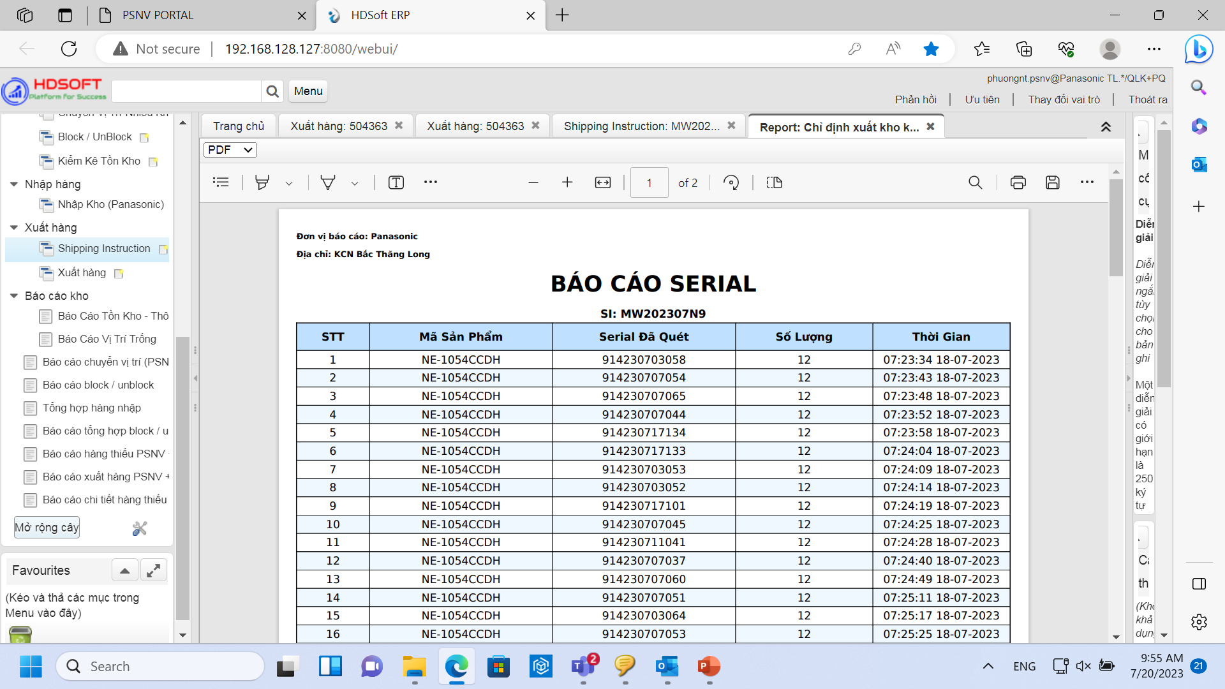
Detail Improvement Activity
1/10
8/10
Theme 2
Standardize electronic stamps
Activity 2.2: Verify OQC judgment result to transfer F/G to SCM for clearance FA W/H
Improvement actions
1. Analysis current process shipment SCM
②
SCM Warehouse
SCM system
③
FA line production
Pallet ID
① FA Warehouse
Check e – chop
Ship to
Market
OK
Send
mail SI
Manual
Confirm SI
Shrink machine
OQC System
Prepare cargo shipping instruction (SI)
Jupiter Warehouse
2. Meeting & discuss: IT - OQC - SCM
❖ Lead time of OQC inspection is long for MW,PJ
<Leadtime MW: 3~6H/1pcs ; PJ: 2~3H/1pcs>
SCM, Jupiter manual confirm SI only quantity
⬥ ①② Not enough space to store F/G
⬥ ③ SI of SCM not verify OQC inspection
⬥ Mixing OK & Not yet OK F/G
3. Create auto link shipment SCM & OQC inspection result
Status OQC inspection
SCM
Create auto
link SI
OQC System
Make function verify shipment
②
③
Make function
upload SI
(SI)
Visualize status shipment
Jupiter
OQC inspection result auto link Pallet ID
SCM & Jupiter Warehouse
✵ Verify the OQC judgment result with SI of SCM (Ensure quality)
Notes:
1m
next slide I talk about the activity 2.2:
Analysis current process shipment SCM.
+After OQC electronic approve, FA will transfer the goods to SCM, but due to the long time OQC inspection for the category microwave & PJ,
+FA, SCM not enough space stored F/G. SCM must transfer to Jupiter.
Before shipment , Jupiter, SCM confirm manual model and quantity. Not compare OQC status inspection easy mixing ok & not yet ok F/G
My activity: I make function to compare shipment SMC & Jupiter with OQC inspection result before ship to market
Purpose : SCM still controls the status of OQC inspection before shipping out of the factory. (1 pit of lot not inspection do not ship to market)
Target action: Ensure quality
The next slide to confirm result.

Slide 10
Confirm result
1/10
9/10
Theme 1
❖ Optimize OQC management process by software
Target
Result
Judge
Activity 1.1
Make software for all steps to reduce manual jobs & Excel files
35 % Normal support
○
65 % Development
Save time:
Δ1,000 (H/Year)
Ensure quality
Save time:
Δ1,080 (H/Year)
Ensure quality
Activity 1.2
Make an auto-link function to visualize SCM shipment shortage data
○
Theme 2
❖ Standardize electronic stamps
Target
Result
Judge
Activity 2.1
Make judgment function to evaluate & visualize inspection result (OQC – FA)
Reduce HC:
Δ2pax
Reduce HC:
Δ1pax (SCBU)/Mar
Δ1pax (Other BD)/Apr
○
Activity 2.2
Verify OQC judgment result to transfer F/G to SCM for clearance FA W/H
Ensure
quality
Ensure
quality
○
Notes:
0,5m

Slide 11
Next Activities
1/10
10/10
For my team
For myself
- Training: Support skill, Training skill, coding skill, analysis skill
- Work team: Learn, sharing, knowledge, experience about factory systems. Transfer some system to other member
- Goal: Make stronger development team
- Study: Method issue and solved problem, level up communication skill
- Job: Control schedule to keep on time support user, own new technology
- Goal: Save time & reduce headcount, ensure quality
Next activities in 2025
NO | Action plan | FY24 |  |  | FY25
 |  | 1 | 2 | 3 | 4 | 5 | 6 | 7 | 8 | 9 | 10 | 11 | 12 | 1 | 2 | 3
1 | Complete optimize OQC process by software & standardize electronic stamps for other BD
2 | Traceability system new product Camera
3 | Digital transformation
4 | Improve my English communication skills
Thank you for your listening!
Notes:
0,5
The last slide I talk about the next activities:
For my team: learning, sharing, knowledge, experience for other member -> My goal :….
For myself: study method issue and solve problem, control schedule keep on time. Find the best solution to save time…
Next activities: ….
That all my report. Thanks for your listening!
If do you have any question, please let me know?

